Slide 1



Development of master curricula for natural disasters risk management in Western Balkan countries
Special mobility strand
Vesna Stankov Jovanović
University of Niš, SERBIA
Second Steering Committee, Project Management Committee and Quality Assurance Committee meetings /September, 19-21, 2017
Project number: 573806-EPP-1-2016-1-RS-EPPKA2-CBHE-JP
"This project has been funded with support from the European Commission. This publication reflects the views only of the author, and the Commission cannot be held responsible for any use which may be made of the information contained therein"

Slide 2
Development of master curricula for natural disasters risk management in Western Balkan countries
Special Mobility Strand (SMS) – General remarks
Individual mobility scheme
  Preparation
  Implementation
  Follow-up
Financial Management
EACEA Mobility Tool
Documents inventory

Slide 3
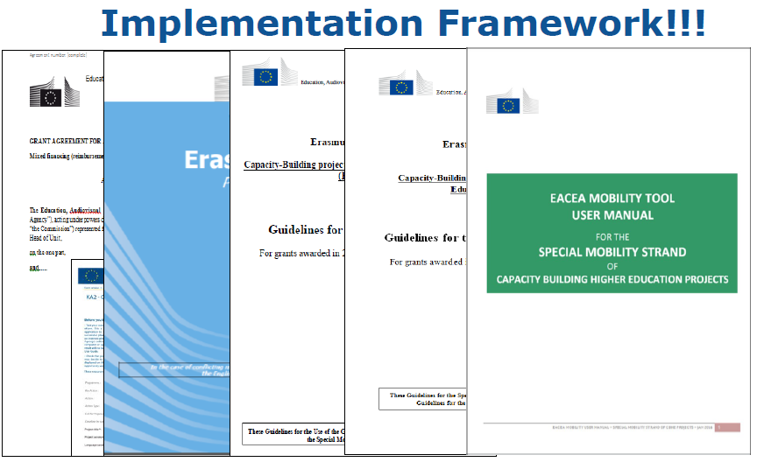
Development of master curricula for natural disasters risk management in Western Balkan countries
https://eacea.ec.europa.eu/mobility/docs/EMT-User-Manual-SMS-ERASMUS.pdf

Slide 4
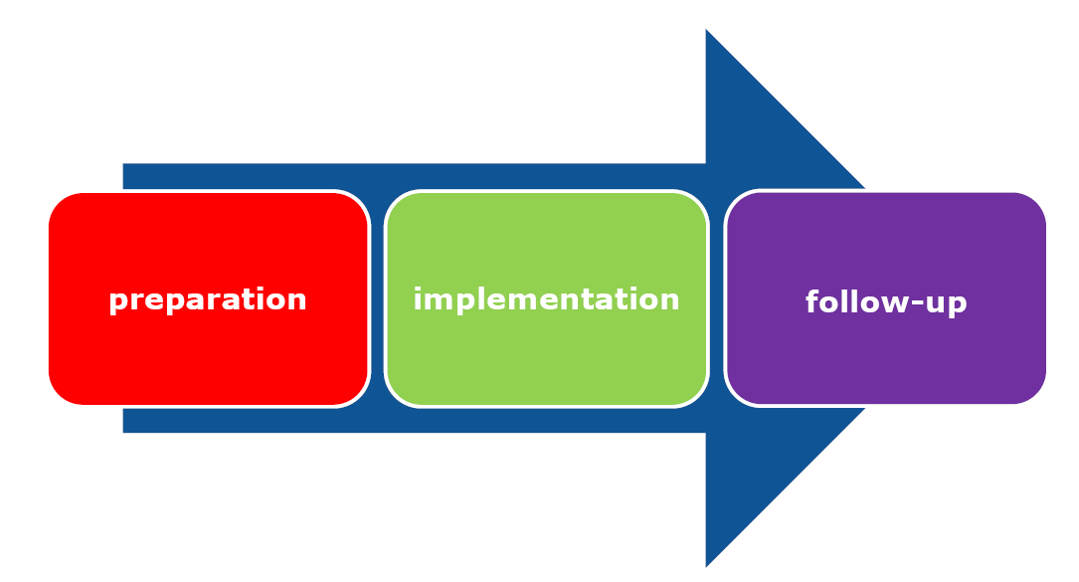
Development of master curricula for natural disasters risk management in Western Balkan countries
Mobility Scheme – main phases

Slide 5


Preparation – basic principles
Development of master curricula for natural disasters risk management in Western Balkan countries
Development of master curricula for natural disasters risk management in Western Balkan countries
Act in accordance with the principles of Erasmus+ Charter for Higher Education (https://ec.europa.eu/programmes/erasmus-plus/sites/erasmusplus/files/files/resources/he-charter_en.pdf)
Relevant information on selection process and admission and selection criteria MUST BE available to candidates well in advance
Ensure commonly agreed methodology and decision making process within the consortia
Associate partners cannot benefit from the SMS
5

Slide 6
Preparation – Inter-institutional agreement
Development of master curricula for natural disasters risk management in Western Balkan countries
Signed by each beneficiary organisation before the selection of the mobility scheme (bilateral)
Provides specific provisions on the roles of the organi-sations, selection procedure, admission/selection criteria, appeal procedures, decision making process, quality assurance measures, etc.
Template available on the CBHE beneficiary space https://eacea.ec.europa.eu/erasmus-plus/beneficiaries-space/capacity-building-in-higher-education_en
minimum requirements must be maintained, but new provisions can be added

Slide 7
Preparation –tasks
Inter-Institutional Agreement (IIA)
Development of master curricula for natural disasters risk management in Western Balkan countries
http://mngt.natrisk.ni.ac.rs/projects/wp7-students_staff/dmsf
Sending Organisation | Receiving Organisation
Promote and raise awareness Select the candidates in line with IIA Provide support in preparation of the individual mobility (visa, administrative issues, insurance, etc.) | Inform locally Prepare logistics and support for incoming individuals Welcome and monitor the activities

Slide 8
Preparation – Learning/Mobility Agreement
Development of master curricula for natural disasters risk management in Western Balkan countries
Grant Agreement for students |  | Grant Agreement for staff
Learning Agreement for |  | Mobility Agreement for
Studies | Traineeship | Teaching | Training
list of courses with ECTS or equivalent targeted learning outcomes formal recognition | knowledge skills competences to be acquired compulsory/ voluntary? Any ECTS? | overall objectives activities and added value foreseen expected outcomes and impact
Learning Agreement and Mobility Agreement must be agreed and signed by the individual, the sending and the receiving organisations before departure

Slide 9
Implementation – basic principles
Development of master curricula for natural disasters risk management in Western Balkan countries
Pre-financing of the grant must be foreseen for the students in order to facilitate the installation process
Receiving organisation and sending organisation have to ensure a constant follow-up and regular monitoring on the individual mobility
All mobility details must be encoded in the EACEA Mobility tool

Slide 10
Follow-up – basic principles
Development of master curricula for natural disasters risk management in Western Balkan countries
Beneficiary organisations involved in SMS commit to:
Recognise the ECTS or equivalent credits obtained by the students during the activities carried out and agreed in the Learning Agreement
Avoid any extension of the study period upon return to take additional exams
Recognise, disseminate and embed the learning outcomes of the staff mobility
Solicit the individuals to fill in the Participant Report before the end of mobility (for students) and right after the end of mobility (for staff)

Slide 11
Financial Management – basic principles
Development of master curricula for natural disasters risk management in Western Balkan countries
The budget granted for the CBHE project and the one granted for the SMS must be kept separated
The SMS funds are aimed at covering two types of costs - the subsistence and travel costs
Individuals cannot benefit at the same time from SMS support and Erasmus+ ICM (Key Action 1)
Students selected must be exempted from paying fees for tuition, registration, examinations and access to laboratory and library facilities at the receiving institution

Slide 12
Subsistence costs – students and staff
Development of master curricula for natural disasters risk management in Western Balkan countries
Subsistence costs for students
The amount must be paid in full and directly to the student concerned
Consortia are strongly recommended to manage their SMS grants in an account in euros
Subsistence costs for staff
Beneficiary organisation in accordance with their institutional practice may decide to either:
Provide the amount directly to the staff members concerned or
Provide the participant with direct provision of the required services (payment of the hotel stay, subsistence, local transportation, personal or optional health insurance, etc.)

Slide 13
Modification of the mobility scheme
Development of master curricula for natural disasters risk management in Western Balkan countries
Regardless of the duration, the minimum number of students and staff members from Partner Countries and Programme Countries as foreseen in the original proposal must be respected!
The figures and the budget allocation for each of the 4 categories are indicated in the Estimated Budget of the Action, Annex III of the CBHE Grant Agreement (GA). Modification is allowed if:
it does not affect the minimum number of mobilities foreseen
the change in the amount of the budget indicated in the GA for one or more mobility categories does not exceed 10%, and
the total estimated budget indicated in the GA is not exceeded

Slide 14
Development of master curricula for natural disasters risk management in Western Balkan countries
GRANT AGREEMENTS
 | UNI | UNID | KPA | UPKM | TCASU | UNSA | VSUP
UNI
UNID
KPA
UPKM
TCASU |  |  | +
UNSA | ? |  |  | ?
VSUP |  |  | ? | ? | ?
BOKU | + |  |  |  |  | ?
MUHEC | + | ? | ? | ? |  | ?
UNIME | + | ? | ? |  |  | ?
OE | + | ? | + | ? |  |  | ?
TUC | + |  | + | + | + | ?

Slide 15
Development of master curricula for natural disasters risk management in Western Balkan countries
INFRASTRUCTURE FOR MOBILITY
BODIES
-International office (officer)- University level
-Academic coordinator of mobility (NatRisk responsable person) Faculty level
-Administrative coordinator of mobility (NatRisk resposable person) Faculty level

Slide 16
Development of master curricula for natural disasters risk management in Western Balkan countries
Development of master curricula for natural disasters risk management in Western Balkan countries
STRATEGIC DOCUMENTS
-EU guidlenes for mobility
-Natrisk guidlines for mobility (in progress)
-University documents concerning mobility (manuals, guides, etc.)
https://www.ni.ac.rs/dokumenti/aktuelni-pravni-propisi-univerziteta-u-nisu/send/118-aktuelni-pravni-propisi-univerziteta-u-nisu/1471-pravilnik-o-postupcima-za-realizaciju-mobilnosti-studenata
https://www.ni.ac.rs/dokumenti/aktuelni-pravni-propisi-univerziteta-u-nisu/send/118-aktuelni-pravni-propisi-univerziteta-u-nisu/436-pravilnik-o-mobilnosti-studenata-glasnik-un-32012
16

Slide 17
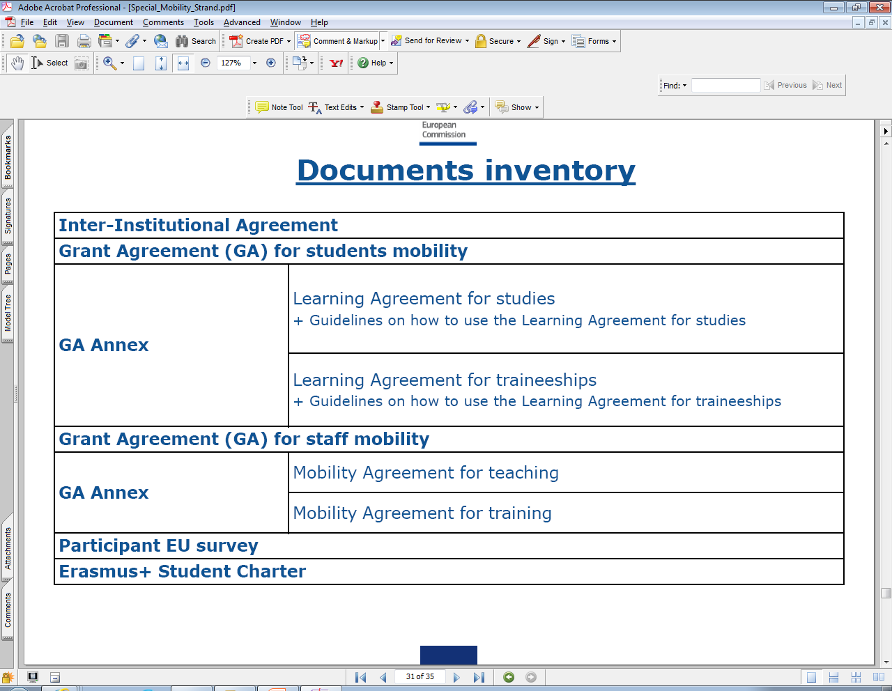
Documents inventory
Development of master curricula for natural disasters risk management in Western Balkan countries
Development of master curricula for natural disasters risk management in Western Balkan countries
Final report for staff and students
https://eacea.ec.europa.eu/erasmus-plus/beneficiaries-space/capacity-building-in-higher-education_en
17
Notes:
Final reports will be done in disseminating purposes with personal impresions, interesting pictures and future recommedations

Slide 18
EACEA Mobility Tool
Development of master curricula for natural disasters risk management in Western Balkan countries
A database aimed at helping the coordinators in the management of the individual mobility (i.e. in keeping information on candidates’ activities, mobility tracks, credits earned, amounts received) and providing the automated reports.
Shortly after selection, coordinator must encode information on participant and the type of mobility activities to be carried out into the EACEA Mobility Tool.
Coordinator must update the tool regularly
to ease the management
for statistical analysis and quantitative assesments
Link: https://eacea.ec.europa.eu/mobility/

Slide 19
Development of master curricula for natural disasters risk management in Western Balkan countries
All documents regarding mobility (both students and staff) must be signed in FOUR copies, and TWO paper versions to be sent to UNI
Each partner need to appoint person responsible for mobility within NatRisk SMS- send an e-mail to
sjvesna@pmf.ni.ac.rs (cc: natrisk@gmail.com)

